Slide 1
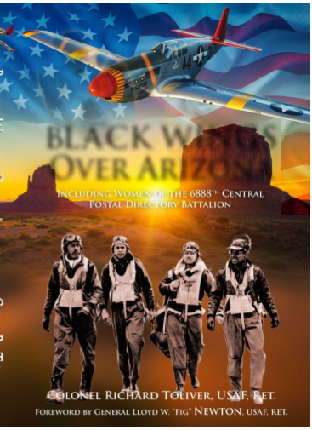
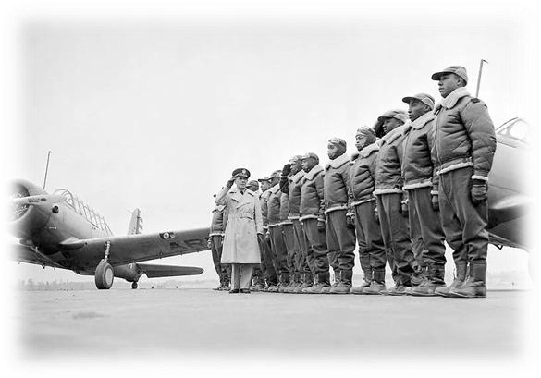
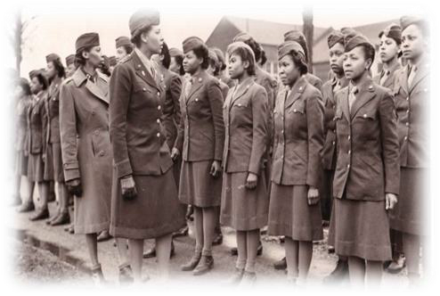
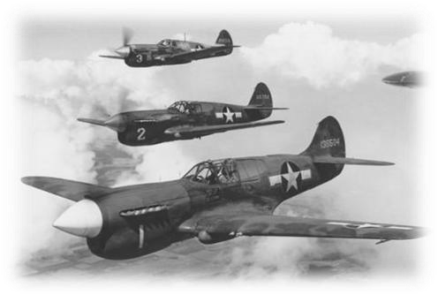
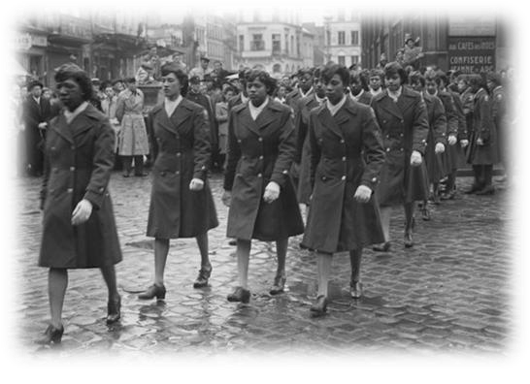
HISTORICAL CONTRIBUTIONS OF AFRICAN AMERICANS
IN AVIATION & THE MILITARY
AN AMERICAN HERITAGE
Courtesy of the Archer-Ragsdale Arizona Chapter, Tuskegee Airmen, Inc
Phoenix, Arizona – December 2024

Slide 2
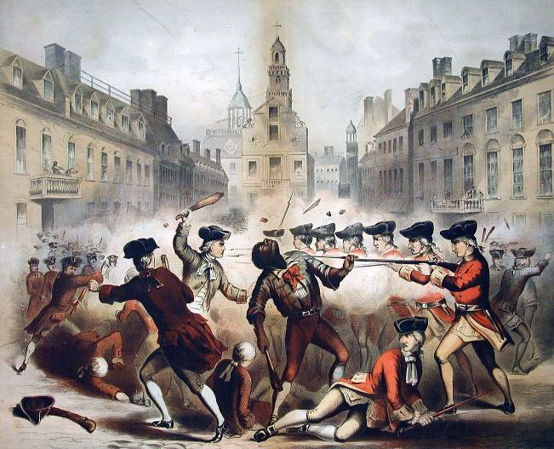
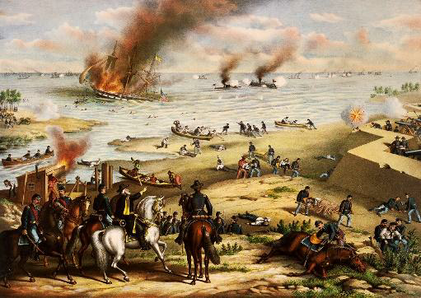
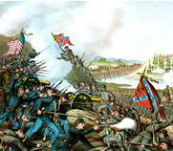
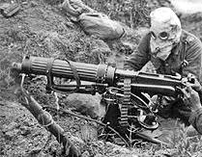
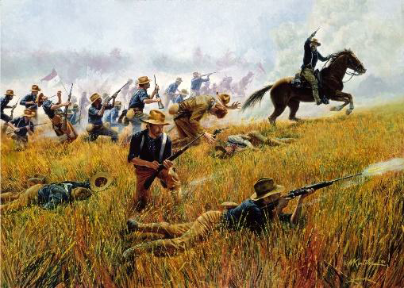
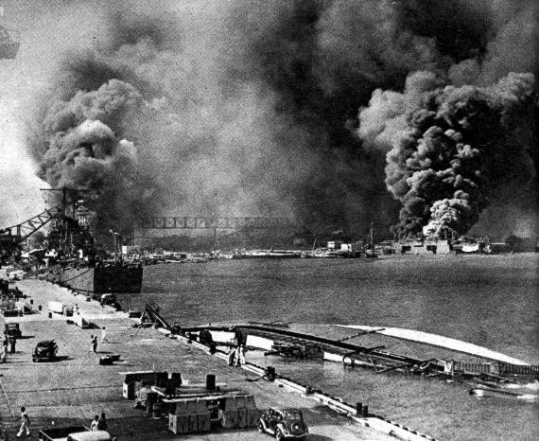
THE HISTORY
•THE HISTORICAL ROOTS OF BLACK PEOPLE HAVE BEEN
ANCHORED IN THE SOIL OF AMERICA FOR OVER 250 YEARS!
–Their blood, sweat, and tears were drenched on the battlefields in every major
conflict since the American Revolution.
Boston Massacre
_{War of 1812} March 5, 1770
The Civil War
World War I Charge up San Juan Hill
World War II

Slide 3
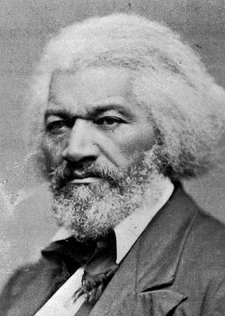
THE HERITAGE
•FREDERICK DOUGLAS - American Social Reformer,
Abolitionist, Orator, Writer, and Statesman:
-- American social reformer, abolitionist, orator, writer, and statesman. .
–Our collective roots in America can be traced back to its genesis; thus, we are indeed
confirmed in the message given by the great Negro orator and statesman, Frederick
Douglass.
oHe was called upon to commemorate the Declaration of
Independence at Rochester, NY in 1852.
oHis assertions then are even more relevant today, and
African Americans can take personal pride and ownership in
this great nation:
“...Black people have plowed, planted, and reaped from the soil of America; we have
erected houses; constructed bridges; built ships; and worked the factories; We are
readers, writers, clerks, and secretaries; we are lawyers, doctors, ministers, poets,
authors, editors, orators, and teachers;
We engage in all manners of business enterprises; we are moving, acting, thinking,
planning, and living in families as husbands, wives, and children;
Above all, we worship the Christian's God and look hopefully to a life beyond the Grave.”

Slide 4
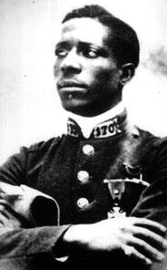
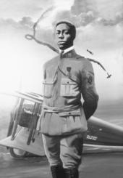
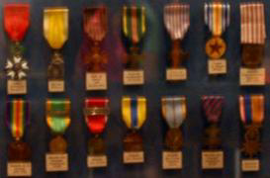
BLACK HEROES IN AVIATION HISTORY
^{•EUGENE JACQUES BULLA}
RD:
–World’s first black fighter pilot.
–Born in October 1894 (?) in Columbus, GA; died on October 12, 1961.
–Joined the French Foreign Legion in 1914 and fought hand-to-hand
combat in the trenches; twice wounded.
–Selected for pilot training in October 1916; became the world’s first
black fighter pilot in May 1917; scored two confirmed “kills.”
Bullard’s Medals

Slide 5
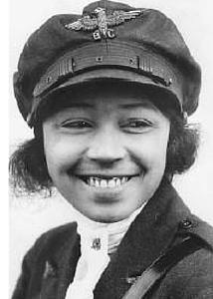
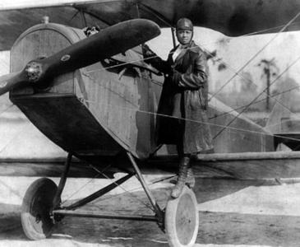
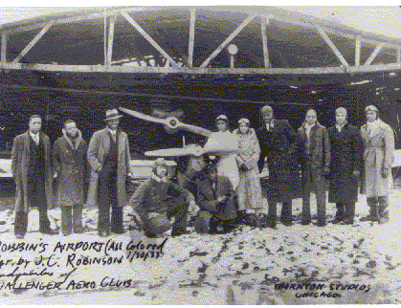
BLACK HEROES IN AVIATION HISTORY
• BESSIE COLEMAN:
–Born 1892 in Texas; self-taught French language.
–Sailed to France for flying lessons
–Earned her International Aviation License on June 15, 1921.
–Returned to the US as America’s first female licensed pilot.
–Started flying school for black women.
–Became known as “Queen Bessie;” refused to perform before a racially
segregated crowd.
–Gained fame barnstorming at air circuses until her untimely accidental
death on April 30, 1926 in Orlando, FL.

Slide 6
THE TUSKEGEE AIRMEN STORY
•OVERCOMING THE BIG LIE - 1925 ARMY WAR COLLEGE REPORT ON
THE USE OF NEGRO MANPOWER IN WAR:
–The War College Report disregarded the outstanding wartime history,
contributions, and performance of black men and women since the American
Revolution.
–The US War Department used a false narrative to bar the advancement of black
men and women in the military
•Declared the Negro to be inferior to whites in behavior, character, and discipline.
•Avowed that the Negro did not have the necessary intelligence to operate and maintain
complex military equipment; especially airplanes.
•CIVILIAN PILOT TRAINING PROGRAM (CPTP):
–December 27, 1938. President Franklin Roosevelt unveiled the Selection Service
& Training Act that authorized the Civilian Pilot Training Program (CPTP)
•Included African American colleges and universities, thus opening doors for the first
black cadets for pilot training
•The onset of World War II and political pressure compelled the US Army Air Corps to
employ African Americans graduates of CPTP as officers and pilots.

Slide 7
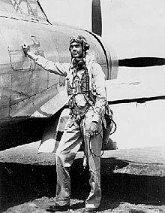
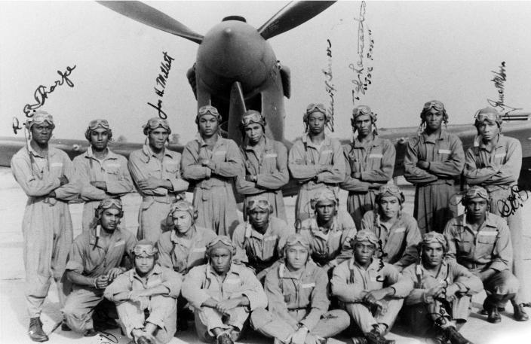
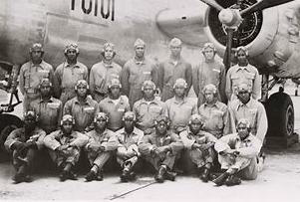
332nd Fighter Group and 477th Bombardment Group
PART ONE
BRIEF HISTORY OF THE TUSKEGEE AIRMEN
http://upload.wikimedia.org/wikipedia/commons/thumb/8/82/Col_Benjamin_Oliver_Davis%2C_Jr.jpg/220px-Col_Benjamin_Oliver_Davis%2C_Jr.jpg

Slide 8
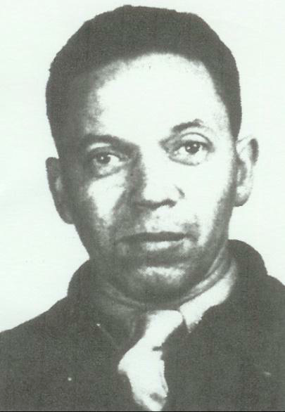
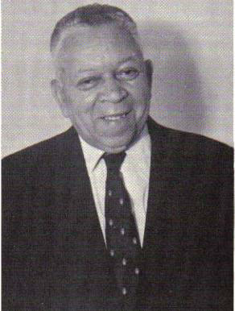
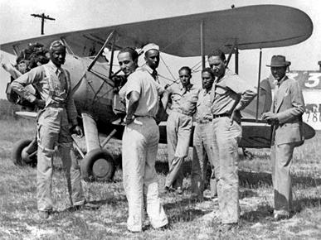
THE TUSKEGEE AIRMEN STORY
•CHARLES ALFRED “CHIEF” ANDERSON (1906-1996):
- Anderson was hired in 1940 by Tuskegee Institute to be its chief flight
instructor.
-Earned a private pilot's license in 1929 and a commercial pilot's license
in 1932.
-Made several history-making, long-distance flights in 1933 accompanied
by his friend Dr. Albert E. Forsythe.
-Considered to be the father of black aviation.
- Honored as an aviation pioneer and master instructor.

Slide 9
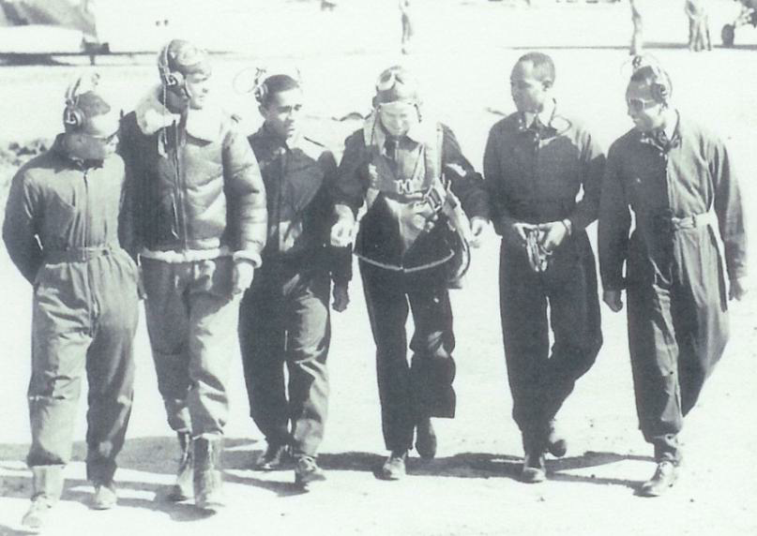
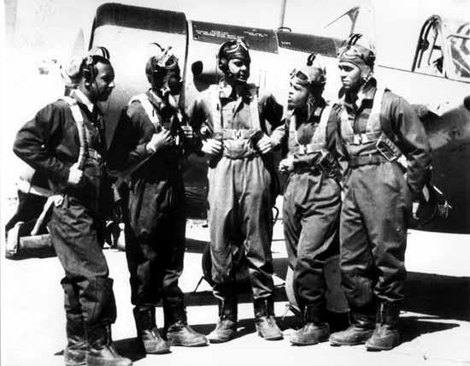
THE TUSKEGEE AIRMEN STORY
•FIRST CLASS OF TUSKEGEE AIRMEN:
–On July 19, 1941, the first group of black cadets began training at Moton
Field, AL (near Tuskegee Institute).
–Members of the first graduating class in March 1942: Capt. B.O. Davis,
Jr. and 2nd Lts. George “Spanky” Roberts, Charles DeBow, Lemuel
Curtis and Mac Ross.

Slide 10
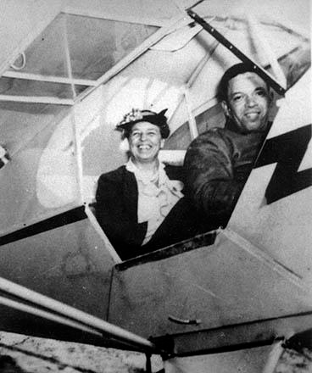
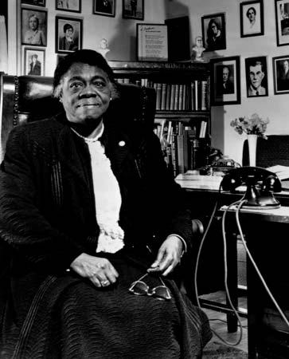
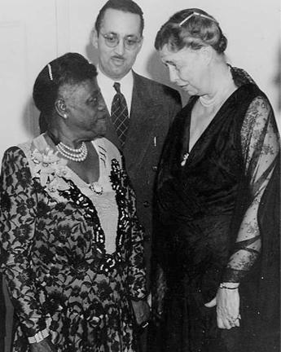
THE TUSKEGEE AIRMEN STORY
•TRIBUTE TO TWO LADIES AND A “CHIEF”:
-The friendship between First Lady Eleanor Roosevelt and Dr. Mary
McLeod Bethune likely resulted in a visit to the Tuskegee training site
and a historic flight with “Chief” Charles Anderson.
-This friendship, visit, and flight ultimately led to the overseas
deployment of the Tuskegee Airmen and participation in WWII.

Slide 11
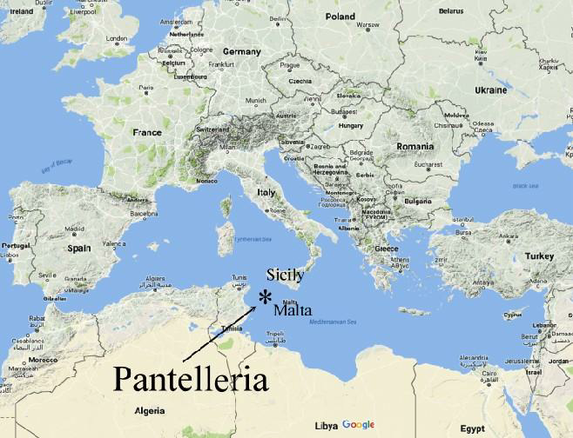
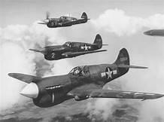
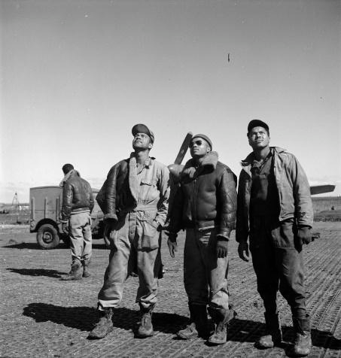
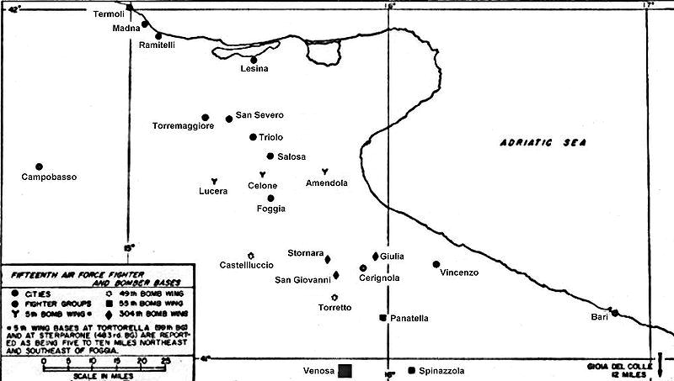
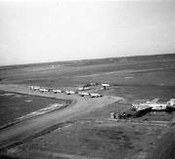
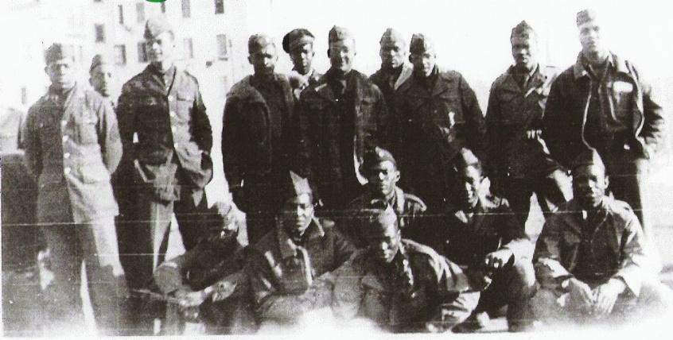
THE TUSKEGEE AIRMEN STORY
•DEPLOYMENT - THEATER OF OPERATIONS 1943-1945:
–North Africa
–Pantellaria
–Sicily
–Ramitelli
File:15thafmap-foggia-italy.jpg
Ramitelli

Slide 12
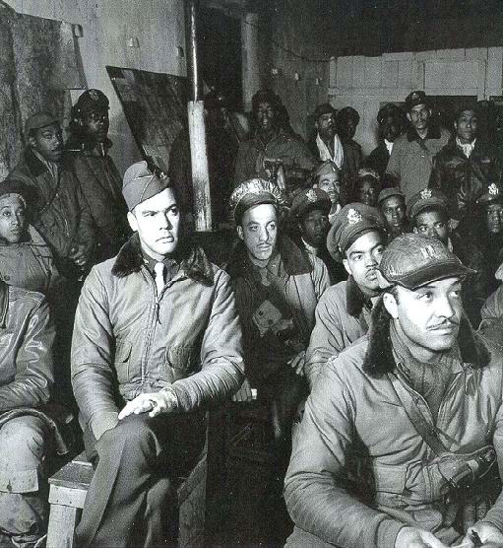
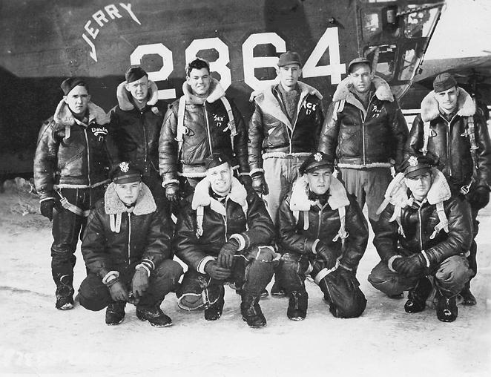
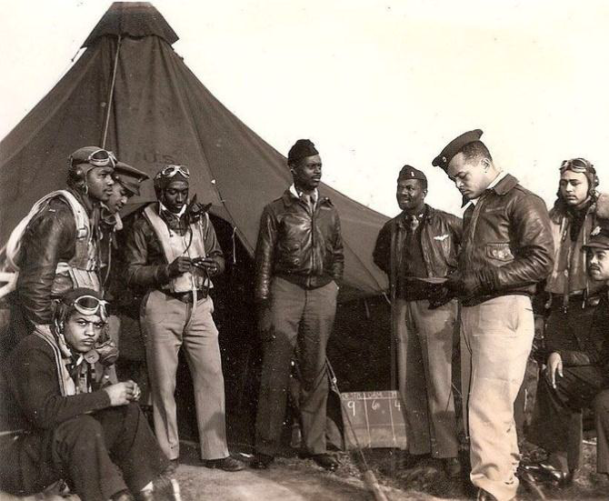
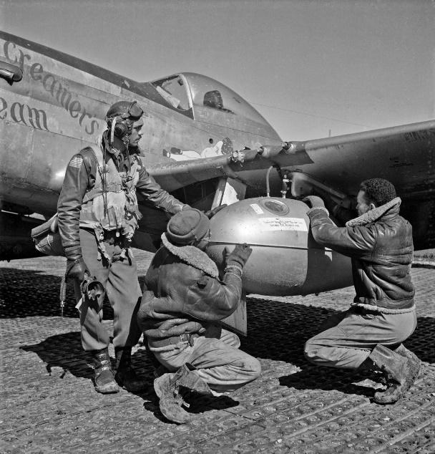
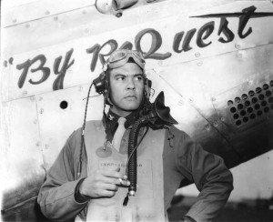
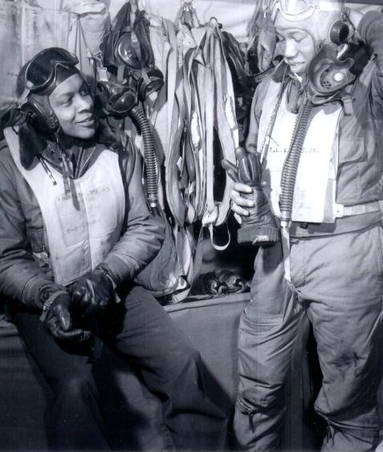
THE TUSKEGEE AIRMEN STORY
•RAMITELLI, ITALY- 332nd FIGHTER GROUP:
Dec 29, 1944 – Jan 4, 1945

Slide 13
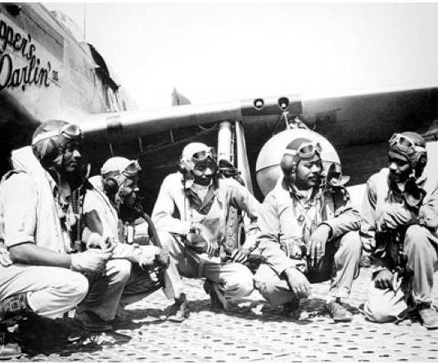
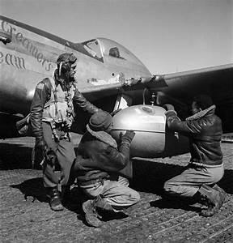
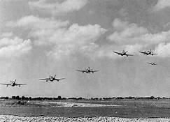
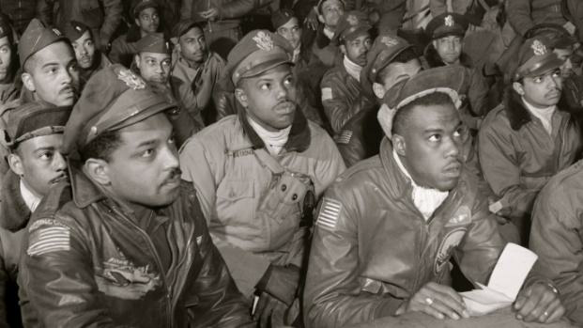
THE TUSKEGEE AIRMEN STORY
•COMBAT PERSONNEL:
–Total number of pilots deployed overseas 450
–Total Killed In Action 66
–Total Prisoners of War 32
–Total number of pilots graduated from Tuskegee 996
•COMBAT PERFORMANCE (12th and 15th Air Force):
–Total missions: 1,578
–Total sorties: 15, 533

Slide 14
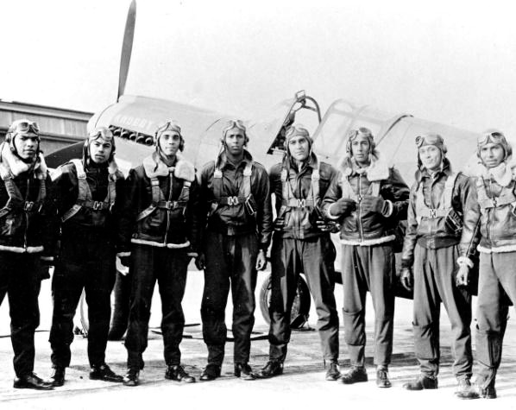
THE TUSKEGEE AIRMEN STORY
•COMBAT RESULTS:
TARGETS DESTROYED DAMAGED TOTAL
Aircraft (Aerial) 111 25 136
Aircraft (Ground) 150 173 323
Barges and boats 16 24 40
Box cars/other rolling stock 58 561 619
Buildings and factories 0 23 23
Gun emplacements 3 0 3
Navy Destroyer 1 0 1
•AWARDS & DECORATIONS:
Legion of Merit 1
Silver Star 1
Distinguished Flying Cross 95*
Air Medals and Clusters 744
Bronze Star 14
Purple Heart 8
*Final total of Distinguish Flying Crosses (Estimated) 150

Slide 15
THE TUSKEGEE AIRMEN STORY
•POST WORLD WAR II:
–After WWII, thousands of those in the Tuskegee Experience returned to
America to continue the struggle for equality, freedom, and justice at
home.
–These great patriots persevered to become doctors, lawyers, educators,
business personnel, entrepreneurs, mayors, and other elected officials
nationwide.
–They blazed the trail for non-violent protest for equal rights and social
change that emerged in the late 1940s and early 1950s.
–Arizona became a part of the Tuskegee Airmen legacy from the
nineteen who established ties to the state in 1945!
•They continued to serve their families, communities, and the nation
with the same dedication, determination, and passion.
•For over seventy-nine years, their outstanding commitment,
dedication, performance, and contributions were at the forefront of
change as civil rights activists, civic leaders, educators, and
entrepreneurs in Arizona

Slide 16
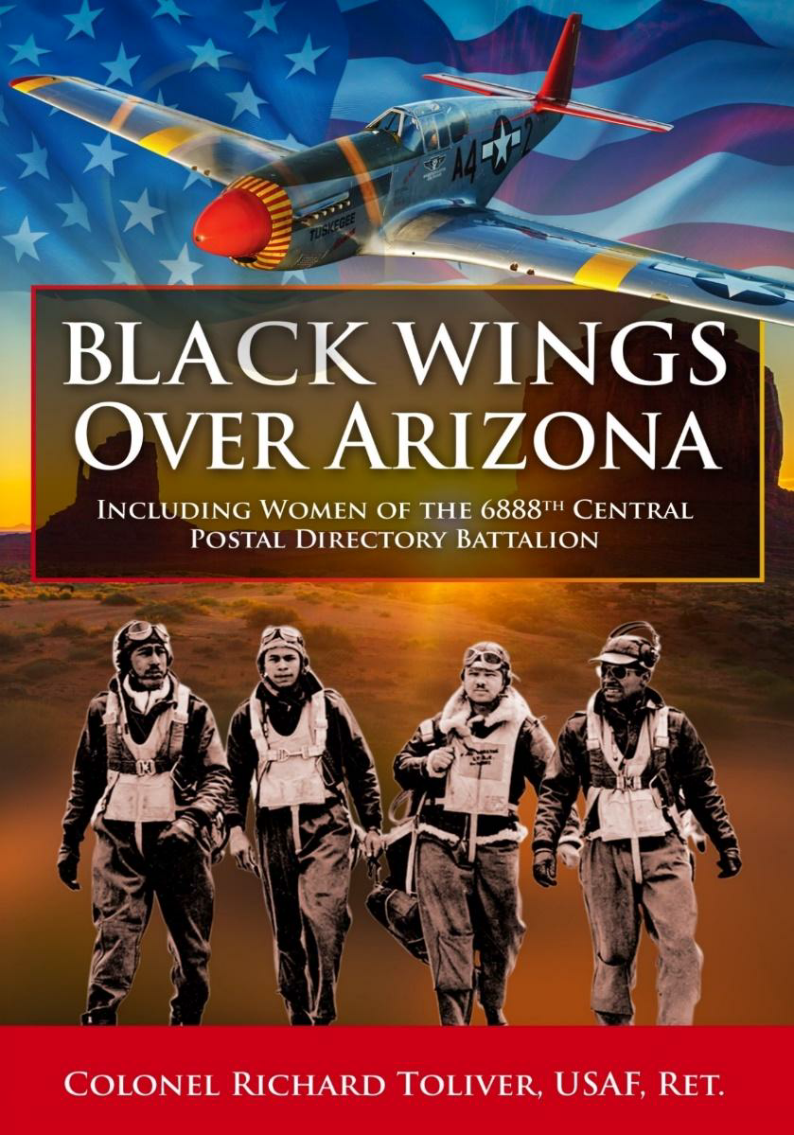
THE REST OF THE STORY!
BLACK WING OVER ARIZONA (BWOA)
- BWOA is the collective history of nineteen
original Tuskegee Airmen who had ties to
Arizona from 1945 to 2024.
-Their stories chronicle the outstanding
commitment, dedication, performance,
and contributions made during and after
WWII.
-They often joined in and led the civil rights
fight to overcome the racial barriers that
persisted after WWII.
- BWOA also includes a brief history of
the 6888th Central Postal Directory
Battalion.
COLONEL RICHARD TOLIVER, USAF, RET
COLONEL RICHARD tOLIVER, USAF, RET.
FOREWORD BY GENERAL LLOYD “FIG” NEWTON
uSAF, RET

Slide 17
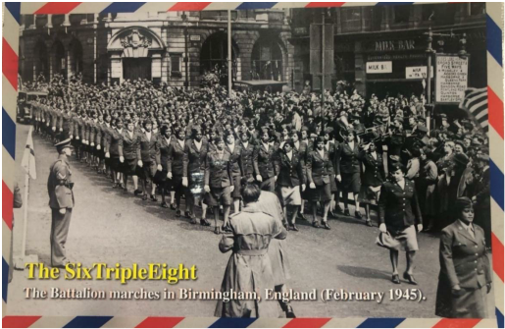
UNSUNG HEROINES OF WWII
•THE 6888TH CENTRAL POSTAL DIRECTORY BATTALION:
-These 855 heroic African American women were sent to Europe in WWII to clear
a two to three-year backlog of mail for the American troops.
-Upon their arrival in England, they had to stand for inspection and march in review
before the white commanders of the Theater of Operations.
-Soon, they would be admired and appreciated for their outstanding courage and
incredible performance in sorting through and delivering years of backlogged mail.

Slide 18
UNSUNG HEROINES OF WWII
•OVERCOMING HURDLES:
–By 1944 during WWII, the critical shortage of soldiers precluded the timely and
effective management of the mail postal service for the US military men and
women overseas.
–To overcome the resultant widespread low morale, Dr. Mary McLeod Bethune and
First Lady Eleanor Roosevelt once again rose to the challenge. They sought a
meaningful role for Negro women in the Women’s Army Auxiliary Corps (WAAC).
–With support from the Army Chief of Staff, General George Marshall, and the
nation’s black media, an authorization bill passed both the House of
Representatives and the Senate in May of 1942. The War Department finally
agreed to admit Negro women, but with only a ten percent quota.
–Dr. Bethune and Mrs. Roosevelt continued their fight until the War Department
directed commanders to accept black Women’s Army Corps (WACs) for overseas
duty, thus paving the way for the formation of the 6888th Central Postal Directory
Battalion.

Slide 19
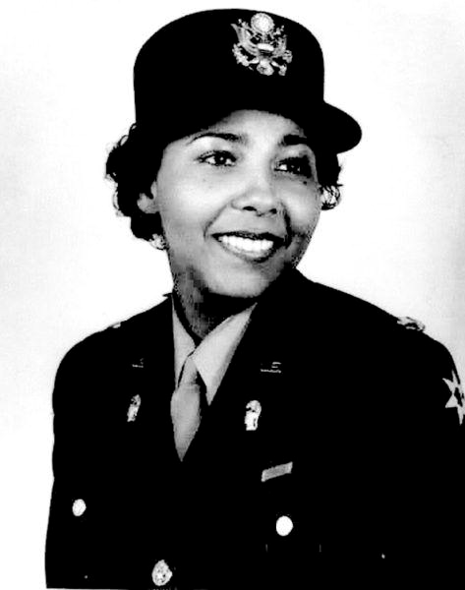
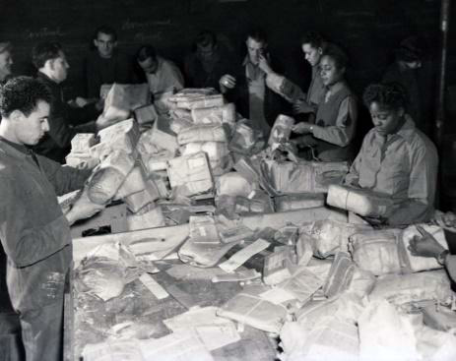
UNSUNG HEROINES OF WWII
•6888TH CENTRAL POSTAL DIRECTORY BATTALION:
–The 6888th Central Postal Directory Battalion was predominantly an all-black
battalion of the Women’s Army Corps (WAC).
–It was comprised of 855 black female officers and enlisted personnel led by Major
Charity Adams Earley.
–It was the only all-black, all-female battalion overseas during WWII.
–The group was nicknamed "Six Triple Eight" and their motto was "No mail, low
morale!
–Most of the 6888th worked as postal clerks, but others held positions such as
cooks, mechanics, and support positions, thus, making it
a self-sufficient unit.

Slide 20
UNSUNG HEROINES OF WWII
•PROVING THEMSELVES:
- Early in the operation, a white general attempted to send a white officer to "tell them
how to do it right," but commander Earley responded, "Sir, over my dead body,
sir!" The battalion finished what was supposed to be a six-month task in three
months in May 1945!
- They were then moved to France to perform a similar task of moving mail that was
backlogged for three years.
- When the war was over, the unit returned to the United States in February 1946
and was disbanded at Fort Dix, New Jersey.
- Three were killed in an accident and buried in France: Sergeant Dolores M.
Browne, Private First Class Mary J. Barlow, and Private First Class Mary H.
Bankston.
- Very sadly, there were no parades or public recognition for the heroic contributions
and service of the 6888th in helping to win the war in Europe!

Slide 21
UNSUNG HEROINES OF WWII
VE DAY, 1945: THEY HELPED WIN THE WAR
AGAINST THE NAZIS!
Marching through the streets of Rouen, France
where Joan of Arc was martyred, May 30, 1431

Slide 22
UNSUNG HEROINES OF WWII
•THE 6888TH IS FINALLY RECOGNIZED!
–Dedication of the 6888th Central Postal Directory Battalion Monument was held
on November 30, 2018, at the Buffalo Soldier Monument Park at Fort
Leavenworth, KS.
–Monument consists of a 25-inch Bronze bust of the unit’s Commanding Officer, Lt.
Col. Charity Adams (Earley), eight black granite panels highlighting the unit’s
lineage, historical information, and key unit pictures.
–The back panel has an alphabetical list, by states, of 800-plus members, of the
original list of 855 assigned during WWII, including three killed in an automobile
accident.

Slide 23
UNSUNG HEROINES OF WWII
•MAJOR (RET) FRANCES “FANNIE” GRIFFIN MCCLENDON AND
HUSBAND MAJOR (RET) ROY MCCLENDON, BOTH USAF:
–Fannie was part of the 6888th that helped redirect mail to more than
seven million members of the US Armed Forces in the European Theater
of Operations, including Army, Navy, Marine Corps, civilians and Red
Cross workers
–She is a 26 ½ year veteran, active member of ARAC, and resides in
Tempe, AZ at 104 years old.
–Her late husband, Roy, was also a 20-year veteran and later taught
school in the East Valley.

Slide 24
UNSUNG HEROINES OF WWII
•RECOGNITION OF THE 6888TH AND MAJOR MCCLENDON:
With Congressman Stanton, Major General Kerry Muehlenbeck, AZ Adjutant General, Col. Wanda
Wright, Col. Edna Cummings, and members of ARAC.

Slide 25
UNSUNG HEROINES OF WWII
•6888th RECOGNITION CONTINUES:
- In 2019, the documentary, The Six Triple Eight: No Mail, Low Morale, directed
by historian James Theres was released. Theres also helped lead the effort for the
monument to the Six Triple Eight at Fort Leavenworth, KS.
- In 2022, the story of the 6888th Central Postal Directory Battalion inspired the
development of a new musical entitled "6888: The Musical”, with Blair Underwood as
executive producer.
- In 2024, Tyler Perry wrote, directed, and produced the movie, “Six Triple Eight,”
based on the legacy of th 6888th Central Postal Directory Battalion .
- THE MOVIE WAS RELEASED IN DECEMBER 2024 AND CAN BE SEEN ON
NETFLIX.
- BWOA HAS BEEN COMPLETED AND IS AVAILABLE AT WWW.ARACTAI.ORG.

